Slide 1
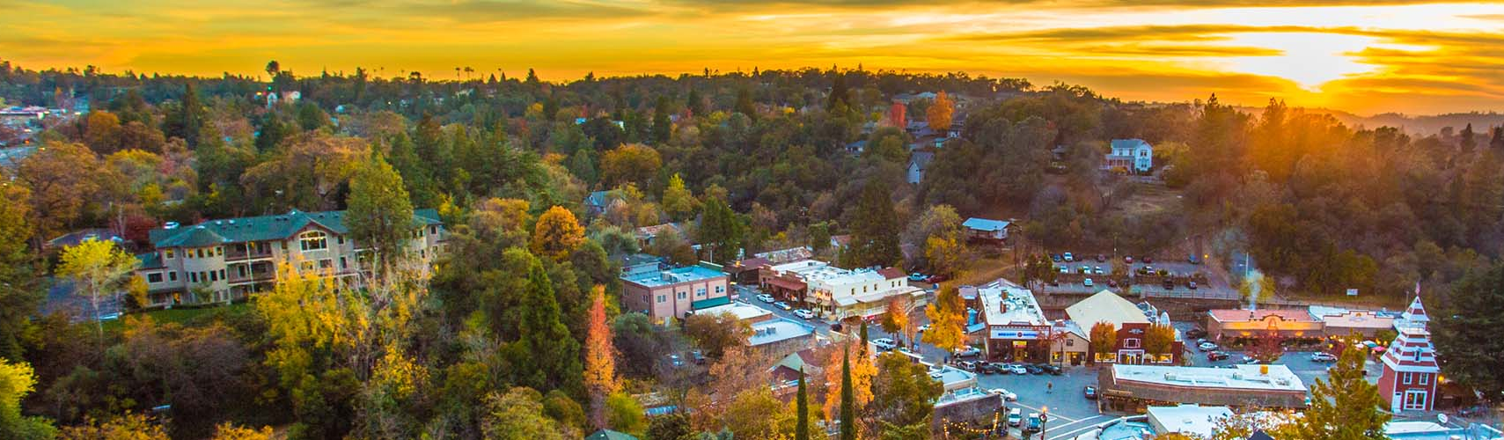
Photo Credit: Placer County
Risk Assessment Overview

Slide 2
Key Definitions
Hazard – Source of harm or difficulty that can be natural or human-made and include social processes that can lead to water shortages in the county.
  Natural hazards, warming temperatures, low income are all hazard examples
Community Assets – The people, structures, facilities, and systems that have value to the community.
  Assets in the DRP must include state small water systems and domestic wells and populations reliant on these water supplies.
Vulnerability – Characteristics of community assets or population that make them susceptible to damage from a given hazard. It includes both physical vulnerability and social vulnerability.
  Physical Vulnerability
  Social Vulnerability

Slide 3
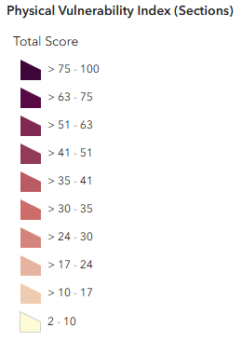
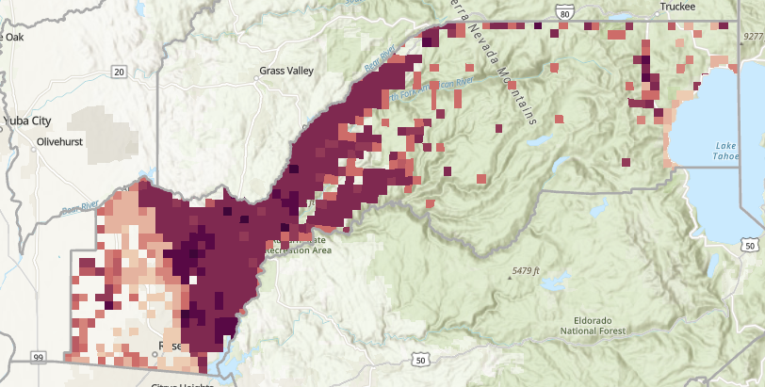
Risk Assessment Objective
Where do physical vulnerabilities intersect with SSWS/domestic wells, and how could social vulnerabilities influence short-term actions and long-term strategies?
Identify vulnerable SSWS and domestic wells within the county
Characterize vulnerabilities
Use outcomes to:
  Assist in areas of focus for the county
  Identify best short-term actions and long-term strategies
What is driving high vulnerability scores?
Are these the vulnerable areas?

Slide 4
Risk Assessment Process
Today’s Meeting
Complete Baseline Risk Assessment
Review the Results with Task Force
Finalize Risk Assessment
Incorporate into DRP
Using the DWR’s Water Shortage Vulnerability Explorer (WSVE) Tool
Submit to Task Force for Review
Incorporate feedback and additional data from PCT and Task Force
Becomes Chapter 3 of DRP, plus the Exhibits Appendix
Outcomes inform the short-term actions and long-term strategies
Notes:
Water Shortage Vulnerability Explorer
-Online geospatial tool that visualizes physical and social vulnerability indicators
-Calculates a total physical vulnerability and social vulnerability score
-Developed to assist counties with evaluating drought and water shortage risks specifically for domestic wells and SSWSs

Slide 5
Physical Vulnerability Score Methodology
Identified 17 indicators of physical vulnerability of domestic wells and SSWSs to water shortages
Calculate a value for each indicator
Indicators’ values are multiplied by their corresponding weighting and summed to determine the total physical vulnerability score
  Indicators weighted based on perceived vulnerability influence
  Aligns with the State Water Board SAFER Program’s Needs Assessment

Slide 6
Physical Vulnerability Indicators with Weights
Climate Change Conditions
Projected Temperature Shift | 1
Saltwater Intrusion in Coastal Groundwater | 1
Wildfire Increase | 1
Current and Recent Environmental Conditions
2024 Precipitation Pattern | 2
Consecutive Dry Years Between 2020 and 2024 | 2
Wildfire Risk | 3
Fractured Rock Area | 5
Presence of Subsidence | 2
Current Saltwater Incursion | 3
Critically Overdrafted Basin | 2
Chronically Declining Water Levels | 3
Presence and Amount of Irrigated Agriculture | 3
Groundwater Water Quality | 3
Infrastructure Conditions
Density of Domestic Wells in Fractured Rock Basins | 5
Dry Well Susceptibility in Alluvial Basins | 5
Dry Well Susceptibility in Fracture Rock Basins | 5
Reported Household Outages on Wells | 3

Slide 7
Social Vulnerability Score Methodology
Applied methodology used by the Center for Disease Control for its social vulnerability index
Indicators primarily sourced from 2020 Census data
Indicators are normalized from 0 to 1 across the state and summed to get the Total Social Vulnerability Score.
Socioeconomic Status
Poverty Level
Unemployment
Per Capita Income
Race and Ethnicity
Persons of Color
Language and Education
Education Attainment
English Language Proficiency
Demographics
Elderly Population
Non-Adult Population
Minority Population
Disability
Single Parent Households
Housing and Transportation
Multi-Unit-Housed Population
Mobile Home-Housed Population
Crowded Conditions
No Vehicle Access

Slide 8
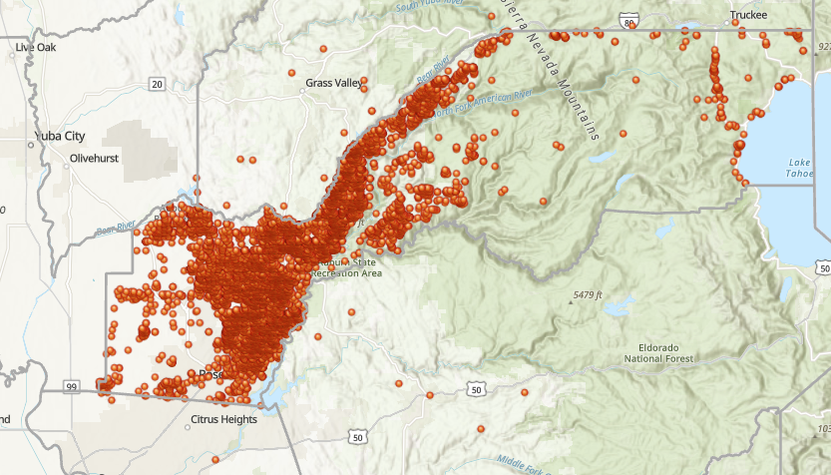
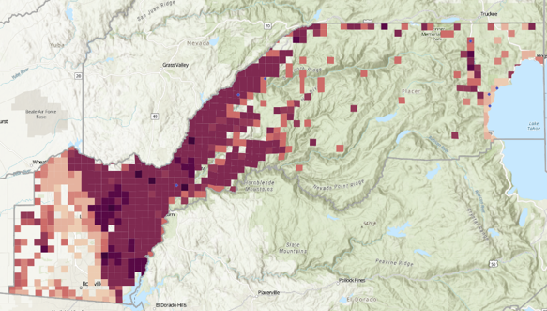
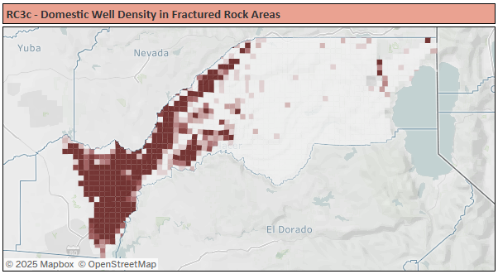
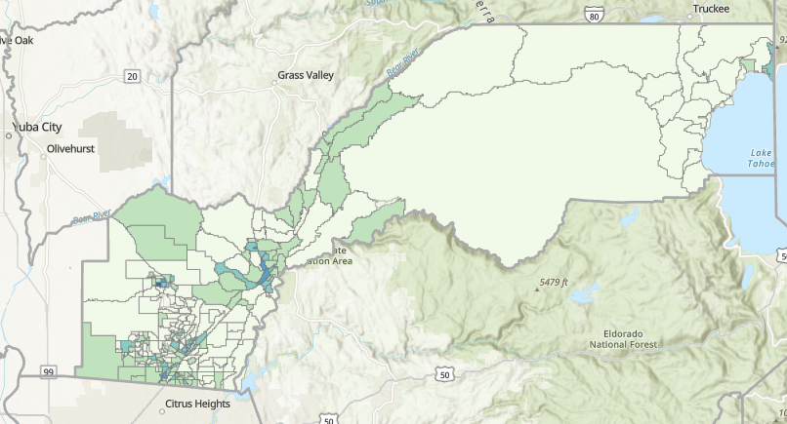
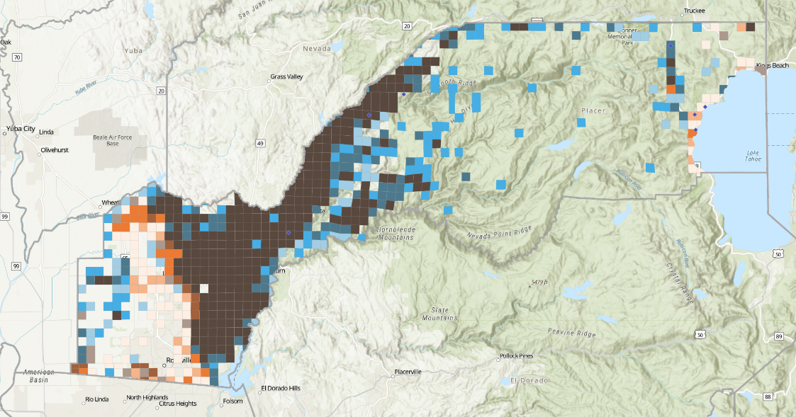
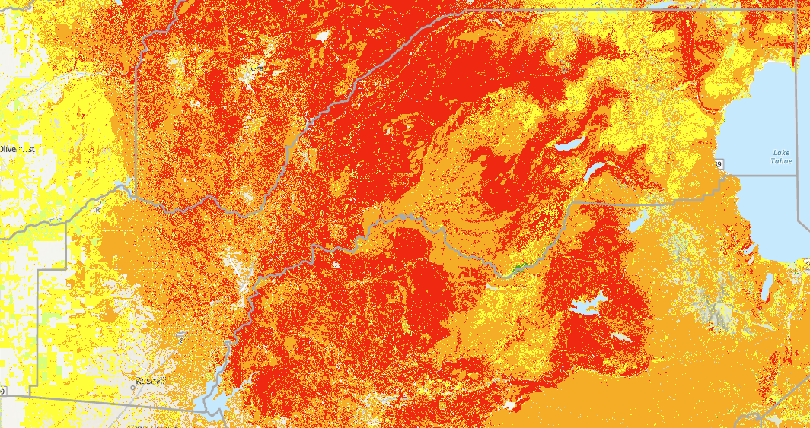
Risk Assessment Analysis
1
Use DWR Risk Assessment tool to evaluate physical and social vulnerabilities within the county
2
Merge with SSWS and domestic wells to determine where the two overlap
4
Characterize how social vulnerabilities intersect
3
Determine what indicators drive physical vulnerability

Slide 9
Photo Credit: Placer County
Risk Assessment Results and Findings

Slide 10
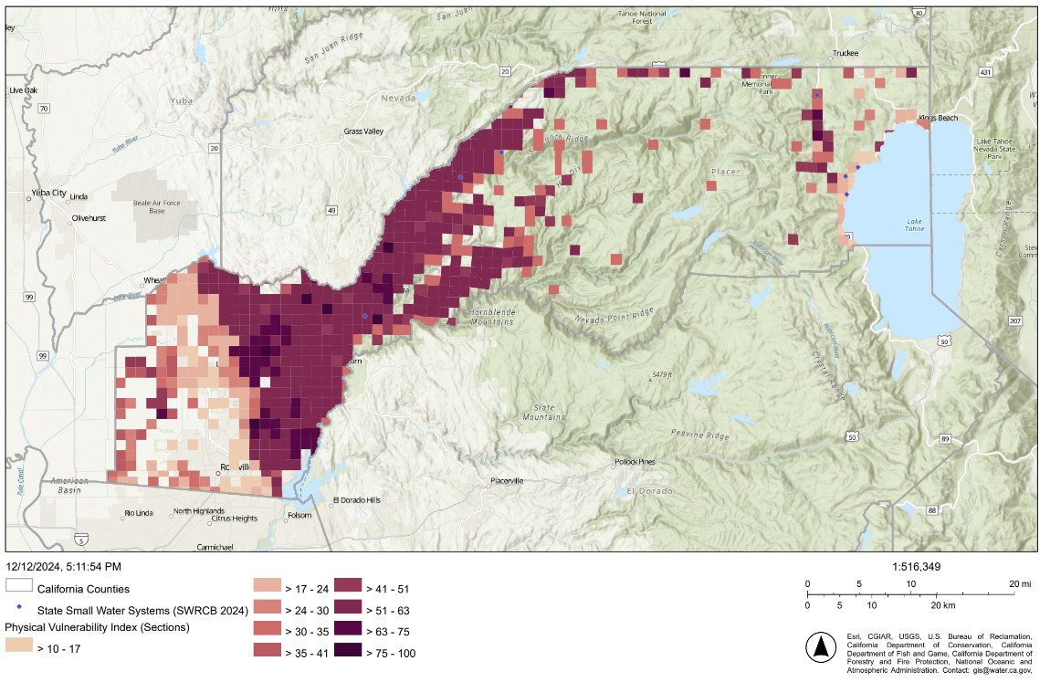
Physical Vulnerability Results
Darker shades indicate higher physical vulnerability
Composite of all physical vulnerability indicators
  Are the areas with physical vulnerability where you expected?

Slide 11
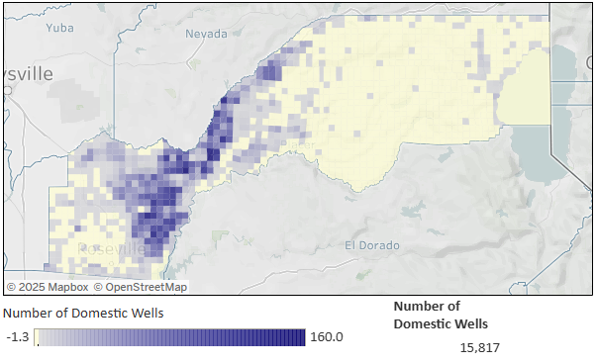
SSWS and Domestic Wells
Any missing SSWS or domestic wells?
(wells may overlap)

Slide 12

Risk Assessment Analysis Results
Combines physical vulnerability with SSWS and domestic well locations
Darker brown indicates high physical vulnerability and high SSWS and domestic well presence

Slide 13
Regions with Water Shortage Vulnerability
Rural Communities within the Sacramento Valley - North American Subbasin in West Placer
Domestic Wells in Fractured Rock Areas within the Lower Elevations of the Western Sierra Nevada Foothills
Domestic Wells in Fractured Rock Areas in the Higher Elevations of the Sierra Nevada Foothills
Isolated Domestic Wells in Fractured Rock Areas in the High Sierra Nevada
D
C
B
A

Slide 14
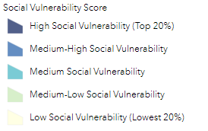
Intersection with Social Vulnerability
Low and Medium Social
Vulnerability
Low and Medium
Social Vulnerability
Low and Medium-High
Social Vulnerability
Low and Medium
Social Vulnerability
D
C
Social Vulnerability Score
High Social Vulnerability Score (Top 20%)
Medium-High Social Vulnerability Score
Medium Social Vulnerability Score
B
Medium-Low Social Vulnerability Score
A
Low Social Vulnerability Score (Lowest 20%)

Slide 15
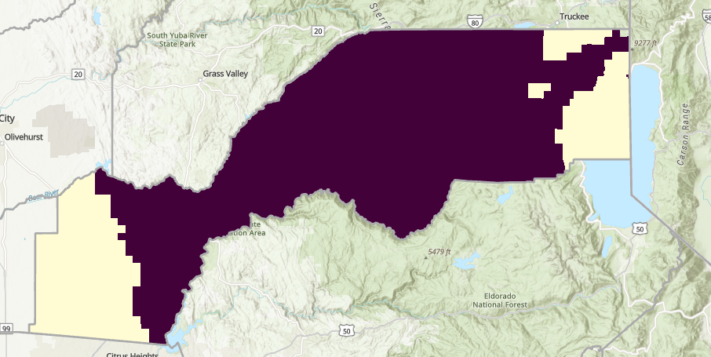

Physical Vulnerability Drivers
Drivers in Fractured Rock Basins
Indicators driving physical vulnerability:
  Dry well susceptibility in fractured rock area
  Multiple dry years within the past five years
  Wildfire Hazard
  Percent land as irrigated agricultural
  Water quality index
Vulnerability results for all indicators are included in the Risk Assessment Appendix

Slide 16
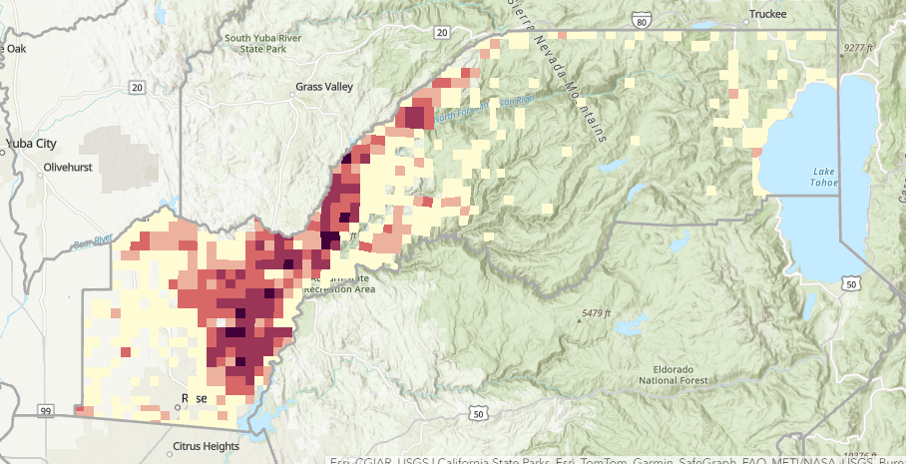
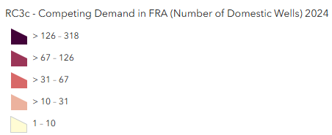
Indicator Detail: Dry Well Susceptibility in Fracture Rock Basins
Indicator Metric:
Density of domestic wells in fractured rock basins
Vulnerability Impact:
Higher density of domestic wells in fractured rock areas increases the vulnerability of well outages, particularly during dry periods

Slide 17
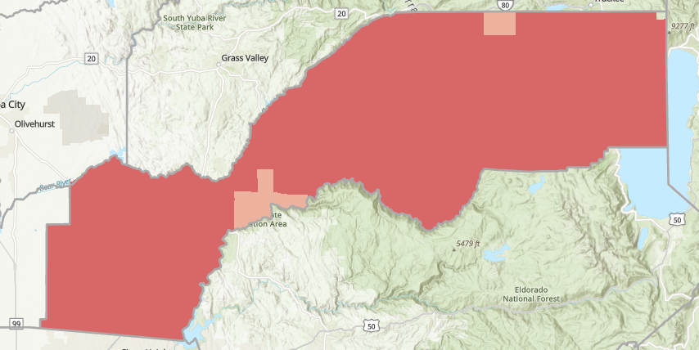
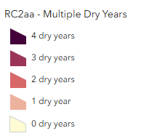
Indicator Detail: Consecutive Dry Years
Indicator Metric:
Count of precipitation less than the average within the last five years.
Vulnerability Impact:
Higher count of dry years could signal a potential near-term challenge in meeting water demands, stressing water resources and infrastructure

Slide 18
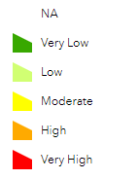
Indicator Detail: Wildfire Risk
US Forest Service Wildfire Hazard Potential
Indicator Metric:
The relative potential for high-intensity wildfire that may be difficult to manage
Vulnerability Impact:
Damage or destroy natural and built infrastructure that can alter water quality and stress water resources
NA
Very Low
Low
Moderate
High
Very High

Slide 19
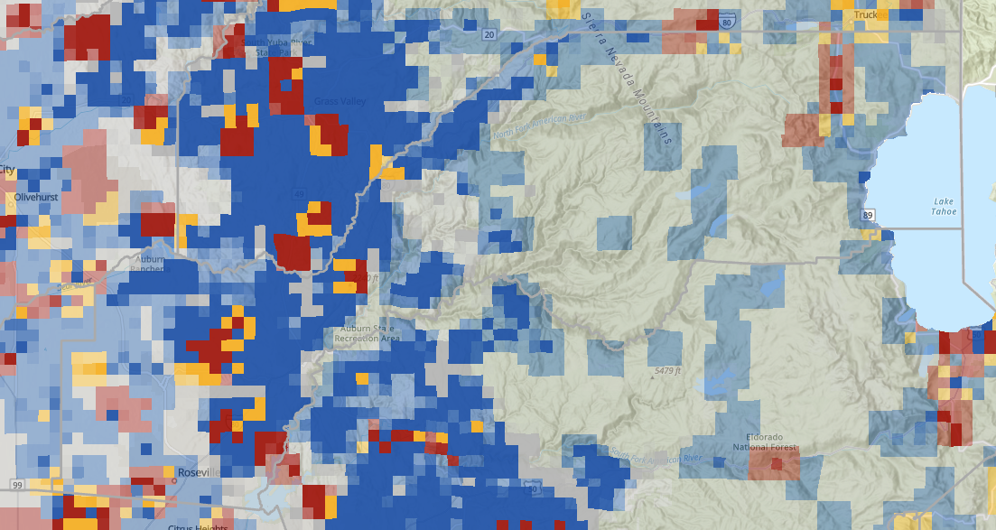

Indicator Detail: Water Quality Risk
California State Water Resources Control Board 2024 Water Quality Risk
Indicator Metric:
Applied 2024 SAFER Needs Assessment for water quality, which shows the raw groundwater quality risk based on existing data. Does not predict or estimate actual water quality at given locations.
Vulnerability Impact:
Increased risk of domestic well or SSWS being unable to deliver drinking water due to water quality impact
SWRCB 2024 Water Quality Risk
high (> comparison concentration)
low (< 80% of comparison concentration)
medium (80% - 100% of comparison concentration)
unknown

Slide 20
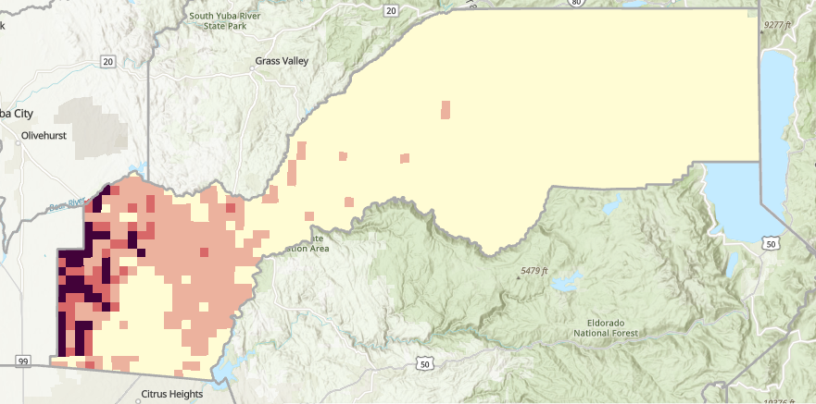
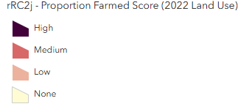
Indicator Detail: Presence of Irrigated Agriculture
Indicator Metric:
Percentage of land use as irrigated agriculture within the County in 2019
Vulnerability Impact:
Increased competition for groundwater supplies during droughts or water shortages, with domestic wells and SSWSs being more vulnerable

Slide 21
Risk Assessment Findings
Regions with Water Shortage Vulnerability and Domestic Wells/SSWSs | Vulnerability Drivers | Social Vulnerability
Rural Communities within the Sacramento Valley - North American Subbasin in West Placer | State Water Board Water Quality Aquifer Risk Dry Domestic Well Susceptibility in Basins Groundwater Level Decline Surrounding Land Use USFS Wildfire Hazard Wildfire Risk | Low to Medium-Low
Domestic Wells in Fractured Rock Areas within the Lower Elevations of the Western Sierra Nevada Foothills | State Water Board Water Quality Aquifer Risk Geology Domestic Well Density in Fractured Rock Areas Temperature Shift USFS Wildfire Hazard | Low to Medium
Domestic Wells in Fractured Rock Areas in the Higher Elevations of the Sierra Nevada Foothills | State Water Board Water Quality Aquifer Risk Geology Domestic Well Density in Fractured Rock Areas USFS Wildfire Hazard Wildfire Risk | Low to Medium-High
Isolated Domestic Wells in Fractured Rock Areas in the High Sierra Nevada | State Water Board Water Quality Aquifer Risk 2024 Precipitation Dry Domestic Well Susceptibility in Basins Geology Temperature Shift USFS Wildfire Hazard Wildfire Risk | Low to Medium

