Slide 1
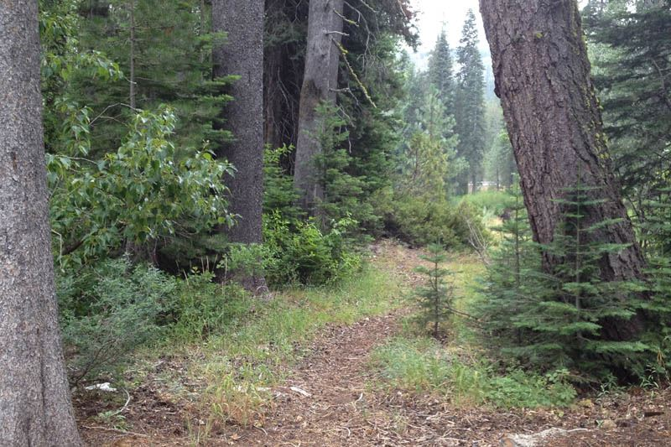

Placer County
Drought Resilience Plan (DRP)
Task Force Meeting 4
Drought Resilience Plan Presentation
January 15, 2026
Photo Credit: Placer County

Slide 2
This presentation summarizes the Placer County Drought Resilience Plan (DRP). Additional detail is available in the DRP, available on the DRP Website:
https://engage.placer.ca.gov/placer-county-drought-resilience-plan

Slide 3
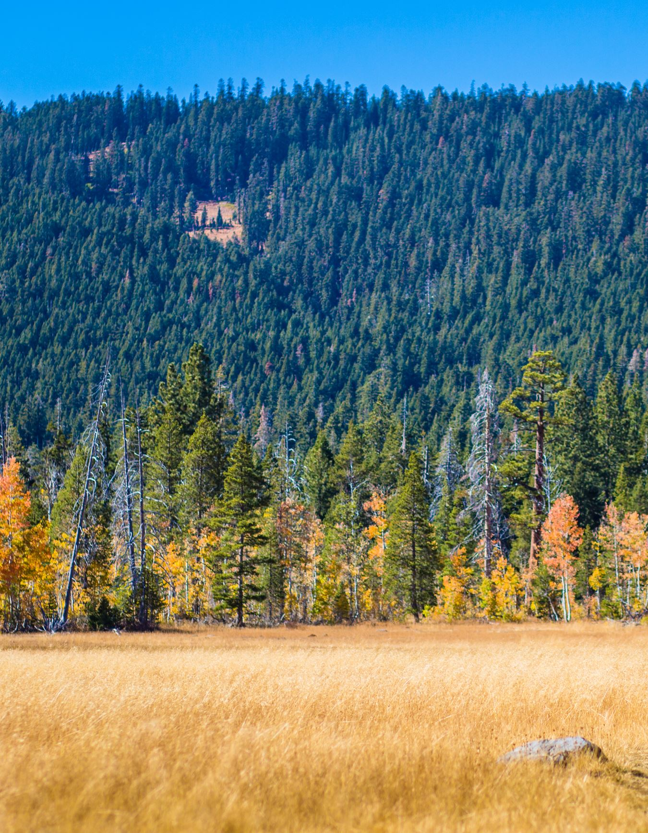
Agenda
Introduction, Purpose, and Scope
Drought and Water Shortage Task Force
Risk Assessment
Actions and Strategies
DRP Implementation
Next Steps
Photo Credit: Placer County
Photo Credit: Mary Davey

Slide 4
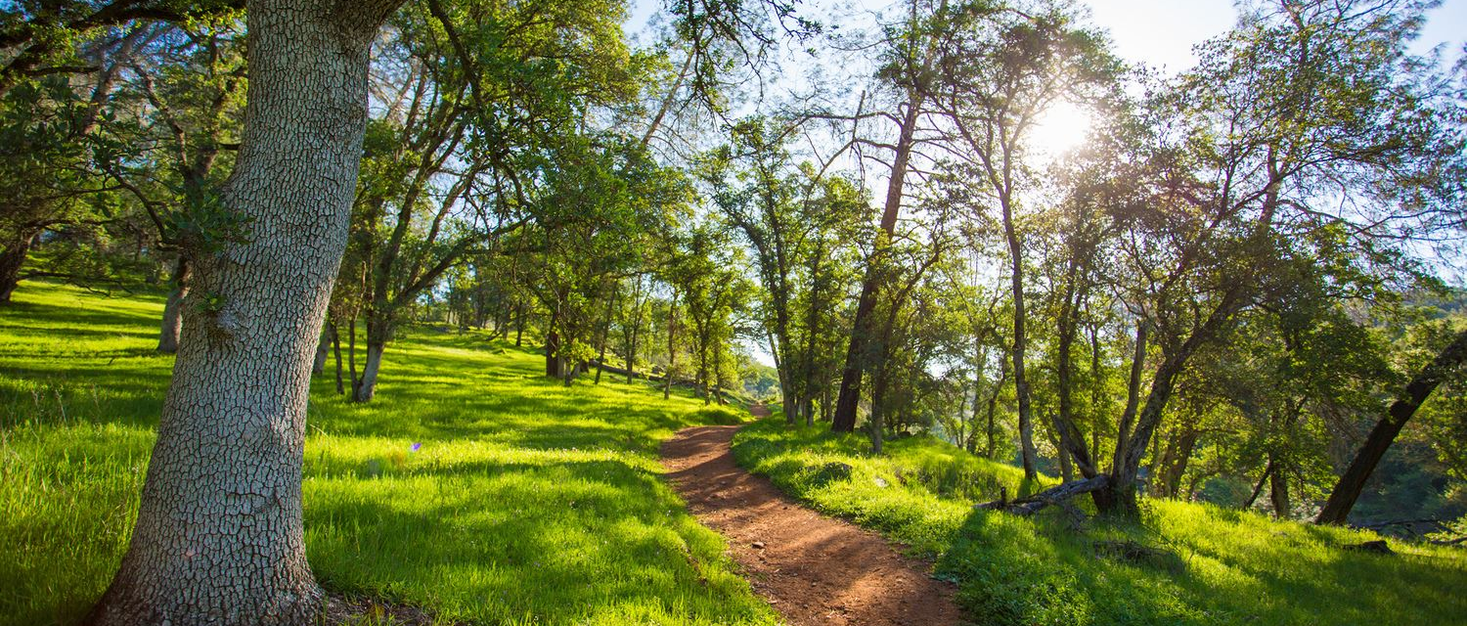
Photo Credit: Placer County
Drought Resilience Plan Introduction, Purpose, and Scope

Slide 5

Preceding Legislation
Assembly Bill 1668 and Senate Bill (SB) 606 (passed in June 2018) outlined directives related to urban and agricultural water use efficiency and countywide drought resiliency.
  10609.40(a) Small water suppliers and rural communities are often not covered by established water shortage planning requirements [...]
  1060940(b) The state should provide guidance to improve drought planning for small water suppliers and rural communities.
  10609.42(a) No later than January 1, 2020, the department [...] shall use available data to identify small water suppliers and rural communities that may be at risk of drought and water shortage vulnerability […], propose to the Governor and the Legislature recommendations and guidance relating to the development and implementation of countywide drought and water shortage contingency plans to address the planning needs of small water suppliers and rural communities.

Slide 6
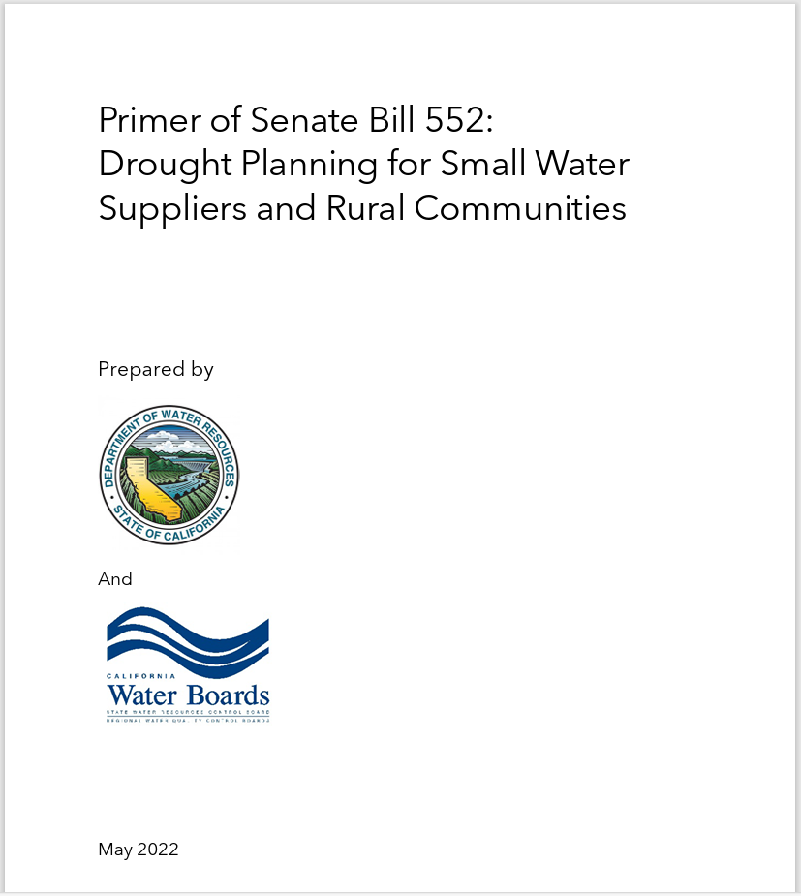
Drought Resilience Plan Purpose
Meet requirements of Senate Bill 552 by:
  Establish a standing county drought and water shortage task force to facilitate drought and water shortage preparedness for state small water systems and domestic wells within the county’s jurisdiction.
  Develop a County Drought Resilience Plan that includes potential drought and water shortage risk and proposed interim and long-term solutions.
Primer-of-SB-552-052522_final.pdf (ca.gov)

Slide 7
Drought Resilience Plan Scope
Systems Covered by the DRP Include:
State small water systems (SSWSs)*: A system for the provision of piped water to the public for human consumption that serves at least 5, but not more than 14, service connections
Domestic wells*: A groundwater well used to supply water for the domestic needs of an individual residence or a water system that has no more than 4 service connections
The DRP covers water shortages due to:
Drought: A period of abnormally dry weather that results in water shortages
Non-Drought Hazards such as wildfires, earthquakes, floods, and extended power shutoffs, and water quality issues, amongst others
*See California Water Code §10609.51 for full definitions

Slide 8
Drought Technical Assistance Program
Drought Resilience Plan prepared through the Department of Water Resources (DWR) Drought Technical Assistance Program
Stantec is contracted through DWR to work directly with counties to develop a DRP
Establish Drought Task Force
A focused Project Coordination Team (PCT) provides review of content prior to the Task Force
Conduct Risk Assessment
Use physical and social vulnerabilities to identify where water supply shortages could occur
Align Actions and Strategies
Detail how the county can respond to droughts or water shortages
Complete Drought Resilience Plan
Memorialize process and outcomes for future use by the county
Current Task
Task Force continues supporting monitoring and implementation.

Slide 9
Drought Resilience Plan Outline
Chapter 1: Introduction
Chapter 2: County Drought and Water Shortage Task Force
Chapter 3: Drought and Water Shortage Risk Assessment
Chapter 4: Short-Term Response Actions
Chapter 5: Long-Term Mitigation Strategy and Actions
Chapter 6: Implementation Considerations
References

Slide 10
Photo Credit: Placer County
Drought and Water Shortage Task Force

Slide 11
Drought and Water Shortage Task Force
SB 552 mandates a standing Drought and Water Shortage Task Force (Task Force). Composition of the Task Force is guided by CWC Section 10609.70:
(a)(1) A county shall establish a standing county drought and water shortage task force to facilitate drought and water shortage preparedness for state small water systems and domestic wells within the county's jurisdiction, and shall invite representatives from the state and other local governments, including groundwater sustainability agencies, and community-based organizations, local water suppliers, and local residents, to participate in the task force.
(a)(2) In lieu of the task force required by paragraph (1), a county may establish an alternative process that facilitates drought and water shortage preparedness for state small water systems and domestic wells within the county's jurisdiction. The alternative process shall provide opportunities for coordinating and communicating with the state and other local governments, community-based organizations, local water suppliers, and local residents on a regular basis and during drought or water shortage emergencies.

Slide 12
Placer County Task Force
Comprised of County departments with a nexus to SSWSs and domestic wells
Meets at least annually to review domestic well and SSWS water supply conditions
Authorized body that makes recommendations to the Board of Supervisors
Task Force Members
Office of Emergency Services
Department of Public Works
Division of Environmental Health
Department of Agriculture Parks and Natural Resources
Department of Public Works
County Executive Office
Placer County Fire Department
Project Coordination Team*
*The Project Coordination Team developed the DRP and are the primary entities responsible for implementation

Slide 13




Drought and Water Shortage Task Force
Responsibilities
Develop SB 552 Drought Resilience Plan
Facilitate water shortage preparedness for domestic well and SSWS communities
Support implementation of Drought Resilience Plan
Coordinate with county departments, local water agencies and suppliers, GSAs, and others

Slide 14
Coordination and Communication
DRP Website to distribute information to domestic well and SSWS communities such as:
  DRP document, resources, county contact info
Notifications via newsletter, social media, DRP website, amongst others
Communication and Engagement Activities such as Board of Supervisor updates, town hall meetings, workshops, and informational presentations
Community Feedback via the DRP website to solicit input
Education Campaigns in partnership with other county entities and water providers and suppliers

Slide 15
Photo Credit: Placer County
Risk Assessment

Slide 16
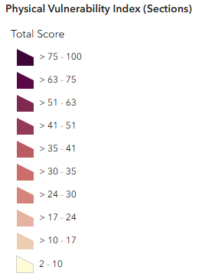
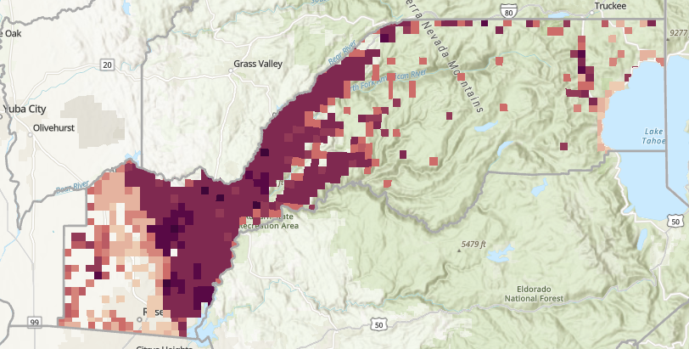
Risk Assessment Objective
Where do physical vulnerabilities intersect with SSWS/domestic wells, and how could social vulnerabilities influence short-term actions and long-term strategies?
Identify vulnerable SSWS and domestic wells within the county
Characterize vulnerabilities
3. Use outcomes to:
  Assist in areas of focus for the county
  Identify best short-term actions and long-term strategies
What is driving high vulnerability scores?
Are these the vulnerable areas?

Slide 17
Risk Assessment Methodology
Apply Water Shortage Vulnerability Explorer Tool (WSVE Tool)
  Developed by DWR in collaboration with County Drought Advisory Group
  Geospatial indicators of physical and social vulnerability
  Customized for domestic well and SSWS communities
WSVE Tool combined 17 physical vulnerability indicators into a total physical vulnerability score at the Public Land Survey Section scale*
WSVE Tool calculated social vulnerability at the Census Block Group scale*
*Detailed physical and social vulnerability methodology and the underlying data is available on the WSVE Tool website

Slide 18
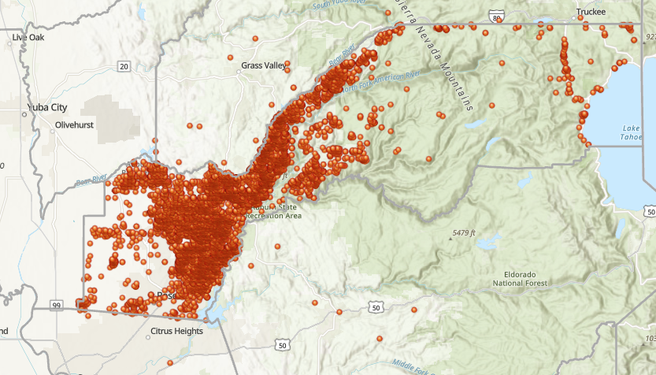
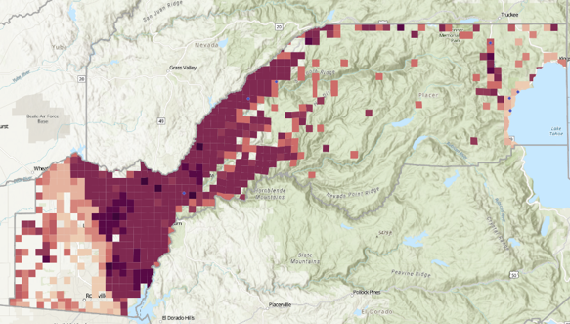
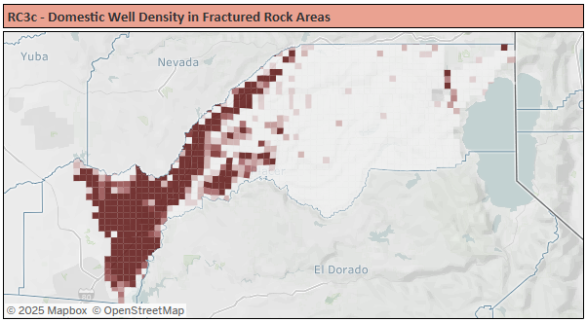
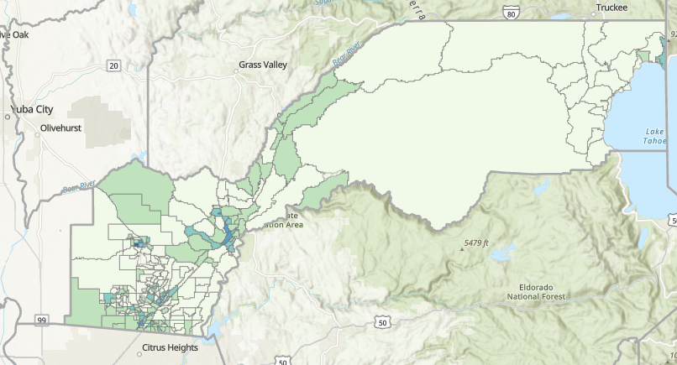
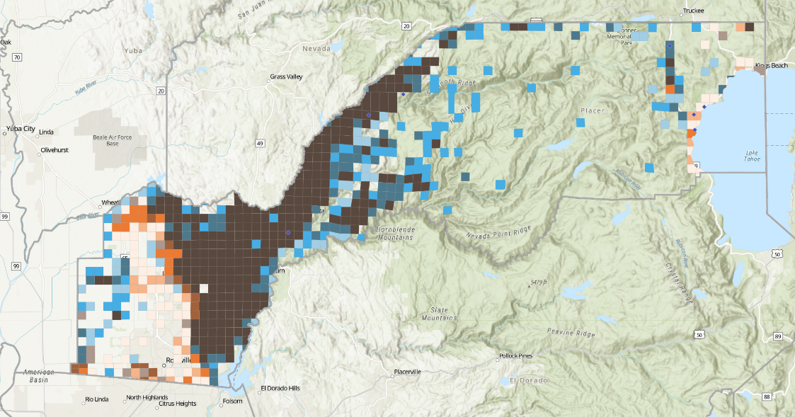
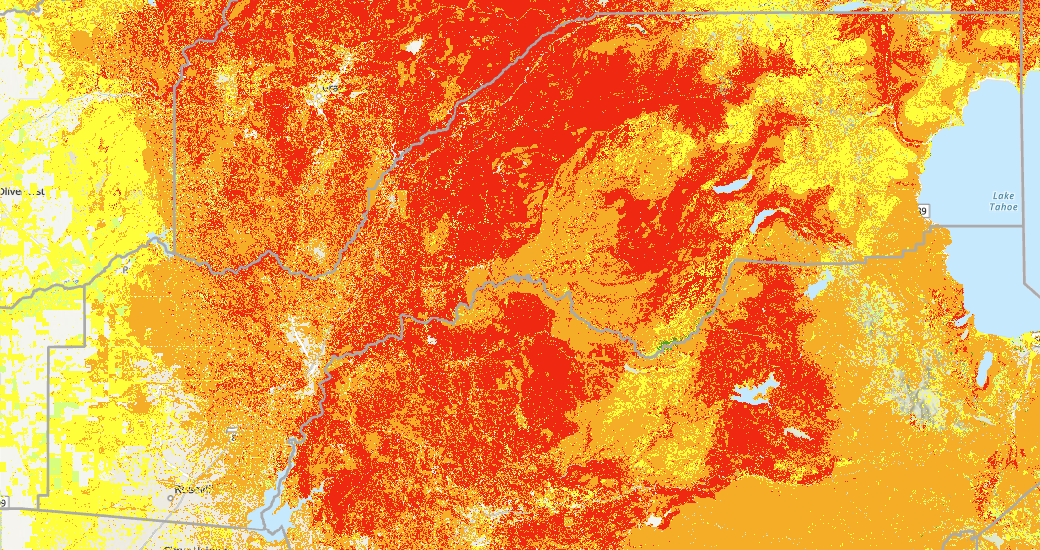
Risk Assessment Analysis
1
Use DWR Risk Assessment tool to evaluate physical and social vulnerabilities within the county
2
Merge with SSWS and domestic wells to determine where the two overlap
4
Characterize how social vulnerabilities intersect
3
Determine what indicators drive physical vulnerability

Slide 19
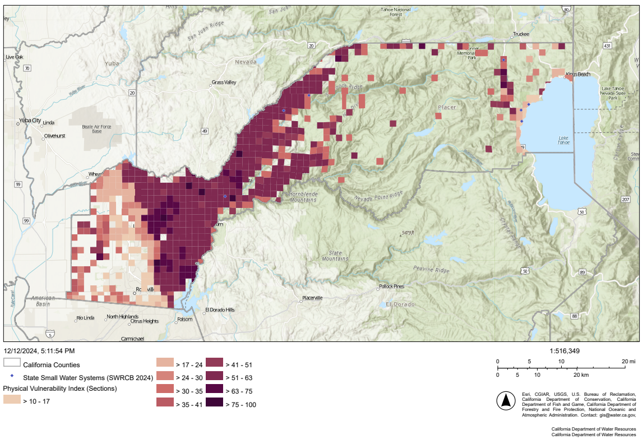
Physical Vulnerability Results
Darker shades indicate higher physical vulnerability
Composite of all physical vulnerability indicators
Non-shaded areas do not have a domestic well

Slide 20
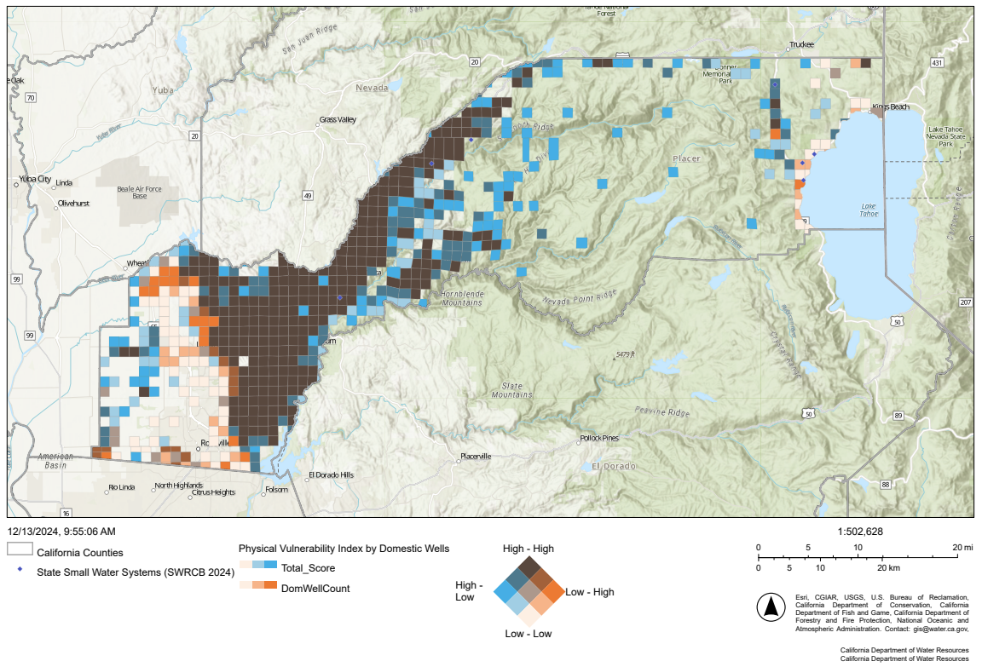
Physical Vulnerability Results
Darker shades indicate higher physical vulnerability
Composite of all physical vulnerability indicators

Slide 21
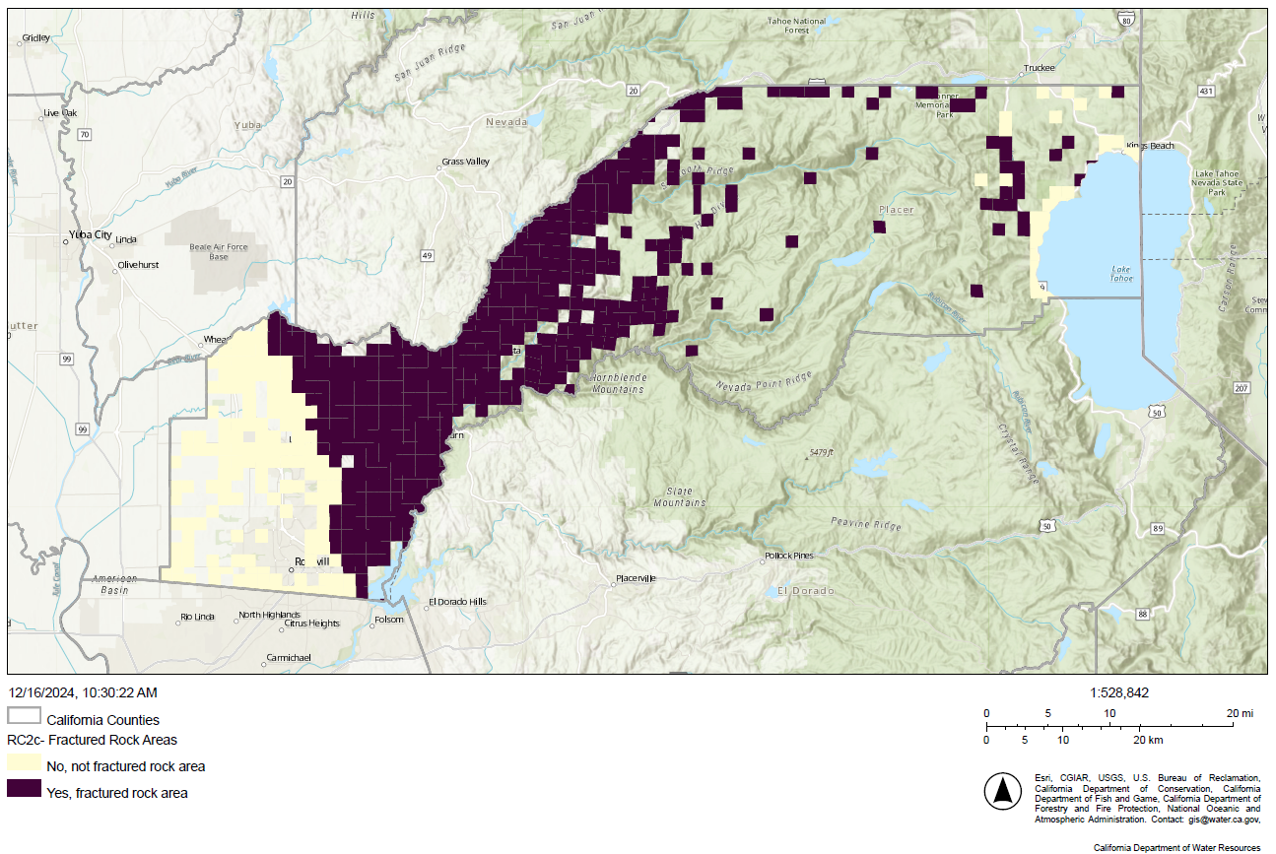
Physical Vulnerability Driver: Domestic Well Density in Fractured Rock Area
Variable water supply reliability
Higher density of domestic wells stresses water supplies
Dark shade indicates fractured rock area

Slide 22
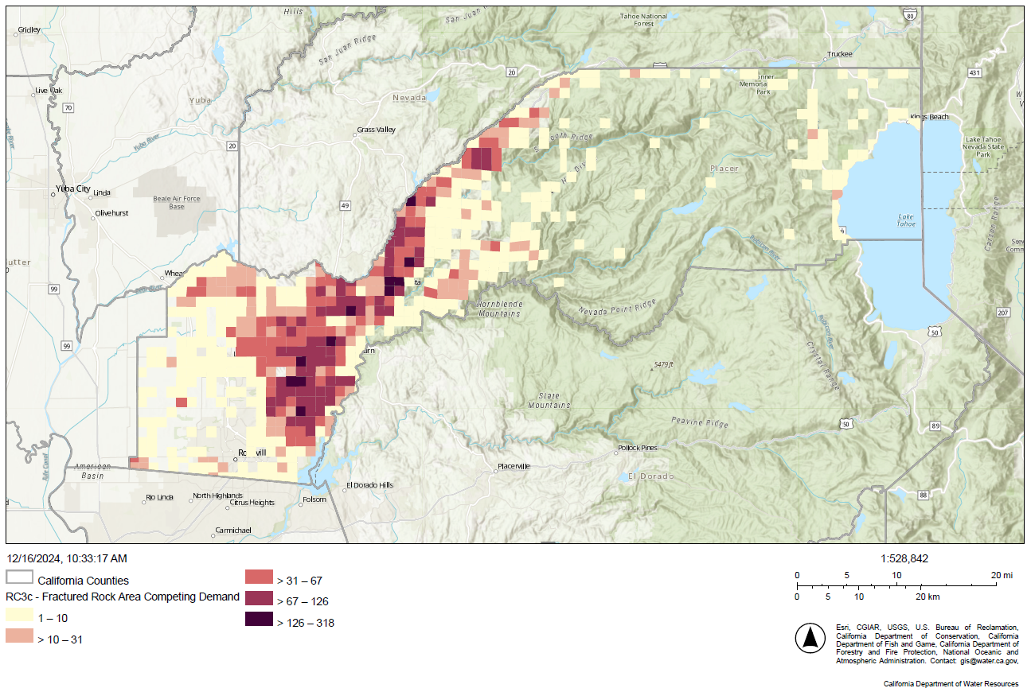
Physical Vulnerability Driver: Domestic Well Density in Fractured Rock Area
Variable water supply reliability
Higher density of domestic wells stresses water supplies
Darker shades indicates higher density of domestic wells

Slide 23
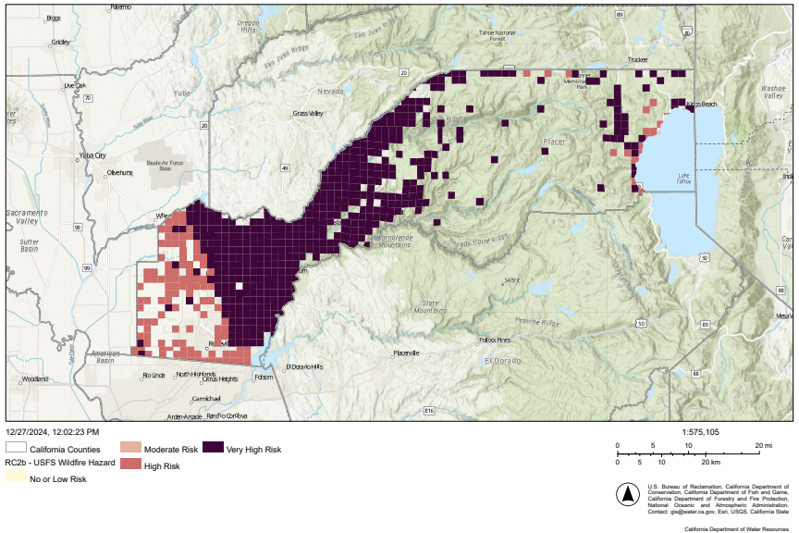
Physical Vulnerability Driver: Wildfire Hazard
Impacts infrastructure, deplete supplies, and affect water quality
Darker shades indicate higher wildfire hazard (as evaluated by USFS)

Slide 24
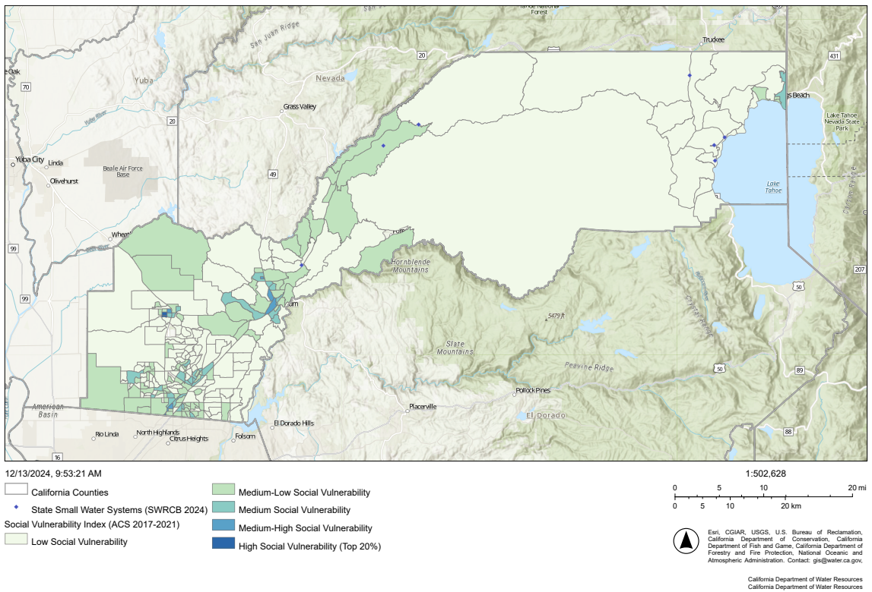
Social Vulnerability Results
Darker shades indicate higher social vulnerability

Slide 25
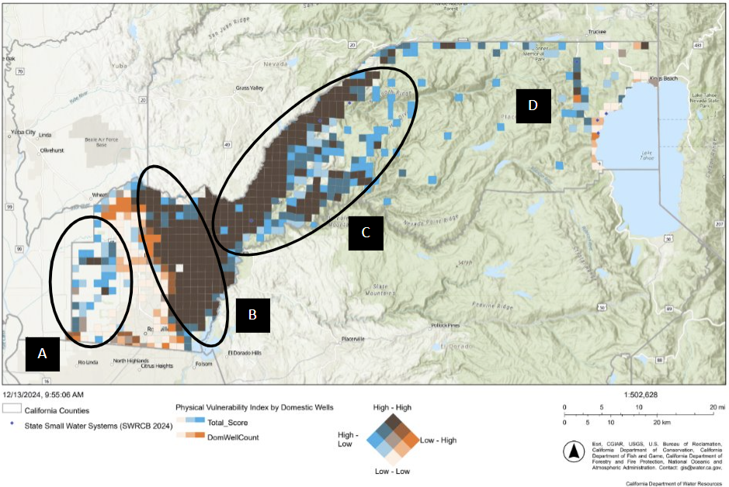
Risk Assessment Findings
Areas with heightened water shortage vulnerability for domestic wells and SSWSs
A: Rural Communities within the Sacramento Valley–North American Subbasin in West Placer
B: Domestic Wells in Fractured Rock Areas within the Lower Elevations of the Western
Placer Nevada Foothills
C: Domestic Wells in Fractured Rock Areas in the Higher Elevations of the
Placer Nevada Foothills
D: Isolated Domestic Wells in Fractured Rock Areas in the High Placer Nevada

Slide 26
Photo Credit: Placer County
Short-Term Response Actions and
Long-Term Mitigation Strategies and Actions

Slide 27
Definitions
Short-Term Response Actions (STRAs) mitigate impacts during drought/water shortage onset and throughout a drought/water shortage event
The DRP identifies STRAs and LTMSAs and describes present and future implementation ability and needs
Long-Term Mitigation Strategies and Actions (LTMSAs) reduce the vulnerability to drought/water shortage events

Slide 28
Legislative Directive: STRAs
SB 552, CWC Section 10609.70:
(b) A county shall develop a plan that includes potential drought and water shortage risk and proposed interim and long-term solutions for state small water systems and domestic wells within the county’s jurisdiction. The plan may be a stand-alone document or may be included as an element in an existing county plan, such as a local hazard mitigation plan, emergency operations plan, climate action plan, or general plan. A county shall consult with its drought task force or alternative coordinating process as established by this section in developing its plan. A county shall consider, at a minimum, all of the following in its plan:
(1) Consolidations for existing water systems and domestic wells.
(2) Domestic well drinking water mitigation programs.
(3) Provision of emergency and interim drinking water solutions.
(4) An analysis of the steps necessary to implement the plan.
(5) An analysis of local, state, and federal funding sources available to implement the plan.

Slide 29
Short-Term Response Actions (STRA) Overview
Evaluated and identified STRAs that provide emergency and interim drinking water supplies
Identified potential pre-negotiated contracts or mutual aid agreements to help efficiently activate STRAs
Developed Drought and Water Shortage Emergency Response Process
  Establishes water shortage stages tied to water supply conditions
  Links County Staff and Task Force activities to each stage
  Emergency and Interim Drinking Water Distribution Plan
    Outlines process for distributing emergency and interim drinking water supplies

Slide 30
Identified STRAs
ID | Short-Term Response Action Name | Short-Term Response Action Description
STRA 01 | Packaged and Bottled Water Supplies | County staff to identify and establish a program to acquire and distribute packaged or bottled water to domestic well and SSWS users during a water shortage emergency.
STRA 02 | Water Hauling, Bulk Water for Existing Tanks and Temporary Locations | County staff to ensure policies and mutual aid agreements are in place for coordination with public water systems that allow for water hauling and bulk water delivery to domestic well and SSWS users with existing bulk water supply storage tanks or temporary distribution locations.
STRA 03 | Dedicated Water Filling Stations | County staff would identify potential locations within public water systems for a network of emergency potable water supply stations. In the future, these locations will be established for use during a water shortage emergency.
STRA 04 | Voluntary Water Conservation | County staff would implement a voluntary water conservation program during droughts with communications targeted to domestic well and SSWS communities.
STRA 05 | Expedited New or Replacement Well Approval During Water Shortage | County staff would, within its jurisdiction, prepare and implement expedited permit authorization for construction of replacement wells that serve domestic well users or SSWSs in the event of a water shortage emergency.

Slide 31
Pre-Negotiated Contracts and Mutual Aid Agreements
Enables efficient material acquisition necessary for the protection of public health, welfare, or safety via existing emergency procurement policies
Procured/negotiated prior to emergency event
Activated in coordination with County, State, or Federal emergency declaration
STRA | Contract or Mutual Aid Agreement Need | Lead | Status
STRA 01: Packaged and Bottled Water Supplies | County needs to procure pre-negotiated contracts for packaged and bottled water vendors. | County OES | Pending
STRA 02: Water Hauling, Bulk Water for Existing and Temporary Tanks | County needs to procure pre-negotiated contracts for bulk water delivery from licensed water haulers. County needs to develop mutual aid agreements with water providers to use with water haulers. | County OES | Pending
STRA 03: Dedicated Water Filling Stations | County needs to develop mutual aid agreement or pre-negotiated contract, as applicable, with water providers to use as dedicated water filling stations. | County OES | Pending

Slide 32
Drought and Water Shortage Emergency Response Process
Drought and water shortage stages
  Information Stage: No major drought or water shortage issues
    General proactive communications
  Alert Stage: Drought is occurring, but no active water shortage emergency
    Additional coordination, communication, and outreach
  Response Stage: Water shortages are occurring or imminent
    Activate Emergency and Interim Drinking Water Distribution Checklist
Stages set by County Staff during annual water supply condition assessment (in October), informed by triggers and conditions, and re-evaluated as needed

Slide 33
Emergency and Interim Drinking Water Distribution Plan (EIDWD Plan)
Summarizes activation, notification, and information collection activities for distributing emergency and interim drinking water supplies
OES is the lead for implementing the EIDWD Plan
Activation:
  Based on water supply conditions assessment or other information
Notification:
  County DRP Website, email, broadcast media, social media, hotline
  Coordination with other organizations (community groups, non-profits, etc.)
Information Collection:
  Cost recovery and to inform future efforts
  Non-personal information such as demographics, general location, and duration of need

Slide 34
Legislative Directive: LTMSAs
SB 552, CWC Section 10609.70:
(b) A county shall develop a plan that includes potential drought and water shortage risk and proposed interim and long-term solutions for state small water systems and domestic wells within the county’s jurisdiction. The plan may be a stand-alone document or may be included as an element in an existing county plan, such as a local hazard mitigation plan, emergency operations plan, climate action plan, or general plan. A county shall consult with its drought task force or alternative coordinating process as established by this section in developing its plan. A county shall consider, at a minimum, all of the following in its plan:
(1) Consolidations for existing water systems and domestic wells.
(2) Domestic well drinking water mitigation programs.
(3) Provision of emergency and interim drinking water solutions.
(4) An analysis of the steps necessary to implement the plan.
(5) An analysis of local, state, and federal funding sources available to implement the plan.

Slide 35
Long-Term Mitigation Strategies and Actions (LTMSA) Overview
Drinking Water Well Mitigation Program
  Series of coordinated efforts that seek to reduce the vulnerability of domestic wells and SSWS to water supply shortages
System Consolidation
  Physical or managerial joining of two or more systems that would include domestic wells and/or SSWS
Regional Water Infrastructure Investment
  Participation in related planning efforts and larger water supply projects to benefit domestic wells and SSWS
Addressing Data Gaps
  Improving planning, forecasting, and monitoring of domestic well and SSWS supplies

Slide 36
Identified LTMSA Summary
16 total
Primarily focused on communication and outreach using the County DRP website
Applying County Staff and partner entity expertise to develop communications specifically for domestic wells and SSWS communities
Includes assistance with existing and future consolidation efforts

Slide 37
Drinking Water Well Mitigation Programs
Drought and Water Shortage Risk Assessment
Communications and Outreach
Water Shortage Prevention
Water Shortage Prevention when Permitting New Wells

Slide 38
Drinking Water Well Mitigation Programs: Risk Assessment and Outreach
ID | Long-Term Mitigation Strategy and Action Name | Long-Term Mitigation Strategy or Action Description
LTMSA 01 | Non-Drought Hazard Assessment | County to assess, as part of its Local Hazard Mitigation Plan, the potential risk for non-drought hazards (e.g., wildfires, earthquakes, landslides, etc.) that could interrupt domestic well or SSWS supplies.
LTMSA 02 | Domestic Well and SSWS Resource Website | County staff create and maintain a website with relevant information (contacts, permits, data, etc.) for domestic well and SSWS communities.
LTMSA 03 | Maintain Network of Vendors and County Contacts | County staff create and maintain a contact list of County departments, well drillers, and laboratories to be shared with domestic well and SSWS communities. The contact list would be posted on the County website.
LTMSA 04 | Supply Interruption Notification for Public Safety Power Shutoffs | County staff, in coordination and collaboration with power utilities, to establish a distribution list of domestic well and SSWS users to contact in advance of public safety power shutoffs. When a power interruption is anticipated, County Staff will coordinate with these entities on initial notification.

Slide 39
Drinking Water Well Mitigation Programs: Well Rehab and Water Shortage Prevention
ID | Long-Term Mitigation Strategy and Action Name | Long-Term Mitigation Strategy or Action Description
LMTSA 05 | Shallow Well Replacement | County staff to provide technical assistance to targeted domestic well owners who are evaluating whether to replace a potentially shallow well. In the future, this could be expanded into a program that provides technical and/or financial assistance to domestic well and SSWSs to replace shallow wells that have in the past, or may in the future, run dry.
LTMSA 06 | Regional Groundwater Level Monitoring and Communication | County staff to update website with existing groundwater level monitoring information. This includes linking to monitoring data from the West Placer GSA .
LTMSA 07 | Water Quality Outreach for Domestic Wells and SSWSs | County staff to update website with groundwater quality information. This includes linking to informational brochures from other entities related to water quality.
LTMSA 08 | Assistance with Domestic Well Monitoring | County staff will coordinate with the West Placer GSA to communicate its available monitoring resources to domestic well and SSWS communities. Within fractured rock areas, the County currently lacks funding to support domestic well monitoring beyond providing contact information for well samplers.
LTMSA 09 | Bulk Water Tank Installation | County staff to outreach to domestic wells and SSWSs with resources for sizing and installing bulk water storage tanks at existing wells. In the future, with additional funding, the County could provide financial assistance for the installation of bulk water tanks and/or power generators.
LTMSA 10 | Grant application assistance to domestic wells and SSWSs | County staff would include on the County website information on potential grants available for domestic well and SSWS communities.

Slide 40
Drinking Water Well Mitigation Programs: Water Shortage Prevention when Permitting New Wells
ID | Long-Term Mitigation Strategy and Action Name | Long-Term Mitigation Strategy or Action Description
LTMSA 11 | Well Permitting Considering Future Growth | County staff, in coordination with the West Placer GSA, to consider ordinance changes that incorporate future growth when permitting a new or replacement well. This would include reviewing development plans, NASb GSP documents, or other information detailing future demands.

Slide 41
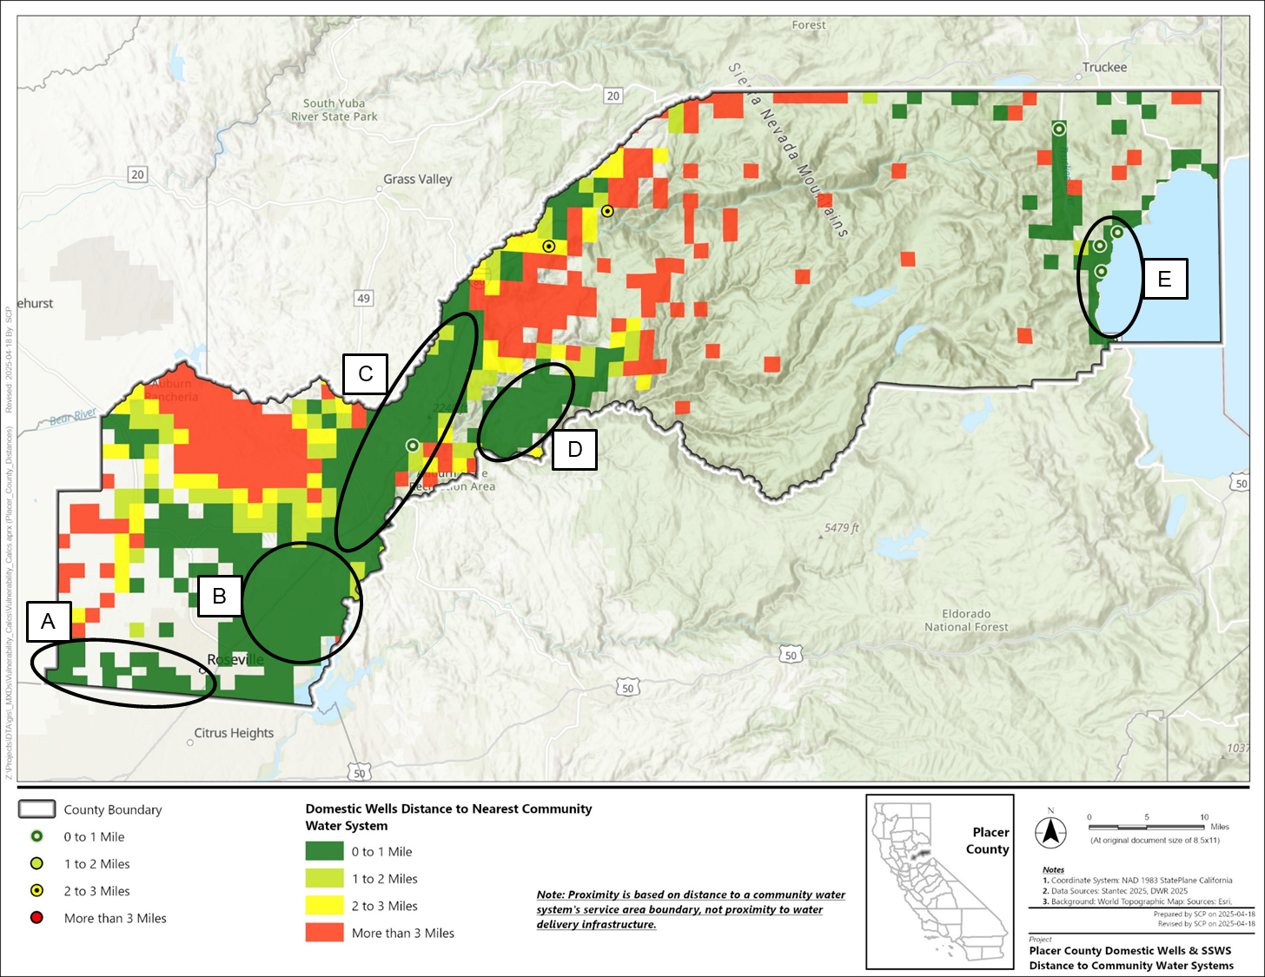
System Consolidation
LTMSA 12: Coordination with PCWA-led system consolidation
LTMSA 13: Potential future system consolidation opportunities
County staff will coordinate with PCWA and support consolidation efforts as identified by domestic well and SSWS communities and community water systems

Slide 42
System Consolidation
LTMSA 13: Potential future system consolidation opportunities
Area of System Consolidation Opportunity | Approximate Number of Domestic Wells | Number of SSWSs | Community Water Systems that Could Be Involved in Consolidation with Domestic Wells or SSWSs
A: Far Southwest Placer County | 200 | 0 | American Water: West Placer
B: Unincorporated Auburn and Newcastle | 3,000 | 0 | Placer County Water Agency: Foothill
C: I-80 Corridor Between Auburn and Colfax | 3,000 | 1 | Christian Valley Park Community Services District Meadow Heights Community Services District Meadow Vista Community Services District Nevada Irrigation District: North Auburn Placer County Water Agency: Applegate, Auburn/Bowman, Colfax, Weimar
D: Foresthill | 350 | 0 | Foresthill Public Utility District
E: Northwest Lake Tahoe Shore | 30 | 3 | American Water: West Placer

Slide 43
Regional Project Integration (1 of 2)
LTMSA 14: Evaluate if planned projects have opportunities to improve water supply resilience for domestic wells and SSWSs
Regional Water Infrastructure Opportunity | Applicability to Domestic Wells and SSWSs | Involved Entities for Coordination
Pleasant Grove Regional WWTP Expansion | Low: Applies to unincorporated regions in the County | City of Roseville
Regional Conjunctive Use Expansion: Phase 1 | Moderate: Lowers municipal groundwater demand in the western region of the County via conjunctive use in non-dry years, which may benefit groundwater levels in nearby domestic wells | West Placer GSA
Complete Planning for Sacramento Regional Water Bank | Moderate: Improves stewardship of groundwater resources in the western region of the County via groundwater storage, which may benefit nearby domestic well users | West Placer GSA
Explore Improvements with North American Subbasin Well Permitting Programs | High: Protects shallow domestic wells with application criteria for new well permits in the western region of the County | West Placer GSA
Domestic/Shallow Well Data Collection and Communication Program | High: Protects shallow domestic wells through informed groundwater management in the western region of the County | West Placer GSA
I-80 Pipeline Crossing Replacement Project | Low: Involves upgrades to surface water conveyance | PCWA
Colfax Water Treatment Plant Expansion | High: increases regional fire-protection capacity, and supports PCWA’s voluntary consolidation program along Interstate 80 | PCWA
Duncan Hill Pipeline Project | High: connects domestic well users with treated water from PCWA via consolidation | PCWA

Slide 44
Regional Project Integration (2 of 2)
LTMSA 14: Evaluate if planned projects have opportunities to improve water supply resilience for domestic wells and SSWSs
Regional Water Infrastructure Opportunity | Applicability to Domestic Wells and SSWSs | Involved Entities for Coordination
Ophir Water Treatment Project | Low: provides water services for future residents; may offset needs for new wells | PCWA
RiverArc Project | Moderate: aims to increase groundwater recharge through shifts in demand to the Sacramento River instead of the American River, which could benefit groundwater levels and thereby domestic well users | PCWA, City of Sacramento, SCWA, West Placer GSA
South Sutter Water District Water System Conveyance System Improvements | Moderate: increases surface water deliveries, which may decrease the need for groundwater use and benefit groundwater levels in part of the western region of the County | South Sutter Water District, West Placer GSA
City of Lincoln Conjunctive Use | Moderate: Offsets groundwater use with recycled water, which may benefit nearby domestic well users | City of Lincoln, West Placer GSA
Sustainable Agricultural Groundwater Recharge Program | Moderate: promotes groundwater recharge in the western region of the County, which may benefit groundwater levels in nearby domestic wells | County, West Placer GSA
Flick Point II Project | Moderate: improves watershed health and water quality near Flick Point, a location near domestic wells | County Public Works
Hidden Fall Trails Expansion Phase 1 ‐ Big Hill Preserve | Moderate: adds an emergency 12,000-gallon water tank in an area near domestic wells | Agriculture, Parks, and Natural Resources

Slide 45
Regional Planning Integration (1 of 2)
LTMSA 15: Participate in County and regional planning efforts to provide perspective of domestic wells and SSWS
Related Planning Effort | Release Date | County Lead | Integration Activity
County General Plan | May 2013; update in progress (Anticipated Completion: 2027) | County OES | County staff will consider where details could be included to benefit water supply resilience for domestic wells and SSWSs during plan updates, and incorporate them to the extent feasible.
Local Hazard Mitigation Plan | June 2021; update in progress (Anticipated Completion: August 2026) | County OES | The Local Hazard Mitigation Plan is currently being updated. For future updates, County staff will consider where details could be included to benefit water supply resilience for domestic wells and SSWSs and incorporate them to the extent feasible.
North American Subbasin Groundwater Sustainability Plan | 2021, with annual updates. 5-year update in progress, due in 2027. | County Public Works | Participate in annual reports and any plan updates, which are currently ongoing.
County Capital Improvement Plan | 2025 | County Public Works | The 2025–2026 fiscal year Capital Improvement Plan has been finalized. For future updates, County staff will track potential projects that are, or could be, included to benefit water supply reliability for domestic wells and SSWSs.

Slide 46
Regional Planning Integration (2 of 2)
LTMSA 15: Participate in County and regional planning efforts to provide perspective of domestic wells and SSWS
Related Planning Effort | Release Date | County Lead | Integration Activity
PCWA County-Wide Master Plan | February 2022 | County OES | County staff will track planned updates to PCWA’s County-Wide Master Plan and coordinate to provide input relating to domestic wells and SSWSs as applicable.
Integrated Regional Water Management Plan: American River Basin, Cosumnes, American, Bear, Yuba, Taho-Seirra | July 2018, July 2021, January 2015, respectively | County Environmental Health | County staff will provide input relating to domestic wells and SSWS as applicable.
Urban Water Management Plans: PCWA, City of Roseville, City of Lincoln | June 2021, June 2021, June 2021, respectively | County Environmental Health | County staff will provide input relating to domestic wells and SSWS as applicable.

Slide 47
Data Gaps
LTMSA 16: Dry Well Reporting and Abandonment
  Update the well permit application so that the applicant must indicate if the new well is replacing a dry well

Slide 48
Photo Credit: Placer County
Drought Resilience Plan Implementation

Slide 49
Legislative Directive: Implementation
SB 552, CWC Section 10609.70:
(b) A county shall develop a plan that includes potential drought and water shortage risk and proposed interim and long-term solutions for state small water systems and domestic wells within the county’s jurisdiction. The plan may be a stand-alone document or may be included as an element in an existing county plan, such as a local hazard mitigation plan, emergency operations plan, climate action plan, or general plan. A county shall consult with its drought task force or alternative coordinating process as established by this section in developing its plan. A county shall consider, at a minimum, all of the following in its plan:
(1) Consolidations for existing water systems and domestic wells.
(2) Domestic well drinking water mitigation programs.
(3) Provision of emergency and interim drinking water solutions.
(4) An analysis of the steps necessary to implement the plan.
(5) An analysis of local, state, and federal funding sources available to implement the plan.

Slide 50
Implementation Roadmap:
Monitoring and Collaboration
Activity | Description | Timing
Task Force Meeting | County OES to schedule and facilitate a minimum of one Task Force meeting annually. The meeting will follow the annual water supply condition assessment (See 4.5.1). The results of this assessment will support County staff, in collaboration with its Task Force, with identifying potential activation of water shortage response measures as described in this plan. | November
Water Supply Monitoring and Coordination | County OES, with County Environmental Health and County Public Works, to engage with agencies/organizations that monitor physical risk factors and water supply conditions to evaluate water supplies associated with domestic well and SSWS communities (See 4.5.1). This will occur before the annual Task Force meeting. | October
Sacramento Valley–North American Subbasin GSA Coordination | County Public Works to participate in meetings with the GSA and review the North American Subbasin Annual Report. May include additional coordination based on water supply conditions. | Annual Report completed in April
Internal Coordination | Annual meeting between County OES, County Environmental Health, and County Public Works to develop the water supply condition assessment. This meeting prepares and reviews the presentation for the annual Task Force meeting. | October
Drought Resilience Plan Website Update | County OES, with County Environmental Health and County Public Works, to update the County DRP content and resource materials at least annually. This includes any contact info, list of resources (vendors, links to external websites, etc.), water supply condition assessment, and other website content. | November and as needed
PCWA Coordination | County Environmental Health and County Public Works to meet with PCWA at least annually to discuss domestic well and SSWS LTMSA opportunities, including system consolidation. | November and as needed

Slide 51
Implementation Roadmap:
Oversight, Responsibilities, Priorities and Needs
Oversight: County OES will oversee implementation, including Task Force coordination and updating the County DRP
  County DRP updated at least every 5 years, or after an emergency event
Responsibility: Each STRA and LTMSA has a County entity responsible for implementation, with support from other entities
Priorities:
  Near-Term: next 2 years
  Mid-Term: 2 to 5 years
  Long-Term: 5 or more years
Resource Needs:
  Additional Staff Time: Reallocation of existing County Staff time or new staff
  County Budget: Additional budget, but could be funded through existing County budget
  External Funds: Additional non-County funds (i.e. grants)

Slide 52
Implementation Roadmap:
Oversight, Responsibilities, Priorities and Needs
Action/Strategy ID and Name | Priority | Status | Resource Requirement
 |  |  | Additional Staff Time | County Budget | External Funds
STRA 01: Packaged and Bottled Water Supplies | Near Term | Available | Yes | Yes | Yes
STRA 02: Water Hauling, Bulk Water for Existing and Temporary Tanks | Mid Term | Proposed | Yes | Yes | Yes
STRA 03: Dedicated Water Filling Stations During a Water Shortage | Long Term | Proposed | Yes | Yes | Yes
STRA 04: Voluntary Water Conservation Program | Near Term | Available | Yes | No | No
STRA 05: Expedited New or Replacement Well Approval During Water Shortage | Near Term | Available | Yes | No | No

Slide 53
Implementation Roadmap:
Oversight, Responsibilities, Priorities and Needs
Action/Strategy ID and Name | Priority | Status | Resource Requirement
 |  |  | Additional Staff Time | County Budget | External Funds
LTMSA 01: Non-Drought Hazard Assessment | Long Term | Proposed | Yes | No | No
LTMSA 02: Domestic Well and SSWS Resource Website | Near Term | Available | Yes | No | No
LTMSA 03: Establish and Maintain Network of Vendors and County Contacts | Near Term | Available | Yes | No | No
LTMSA 04: Supply Interruption Notification for PSPSs | Near Term | Available | Yes | No | No
LTMSA 05: Shallow Well Replacement | Near Term | In Progress | Yes | Yes | Yes
LTMSA 06: Regional Groundwater Level Monitoring and Communication | Near Term | In Progress | Yes | No | No
LTMSA 07: Water Quality Outreach for Domestic Wells and SSWS | Near Term | In Progress | Yes | No | No
LTMSA 08: Assistance with Domestic Well Monitoring | Near Term | Available | Yes | Yes | Yes
LTMSA 09: Bulk Water Tank Installation | Long Term | Proposed | Yes | Yes | Yes

Slide 54
Implementation Roadmap:
Oversight, Responsibilities, Priorities and Needs
Action/Strategy ID and Name | Priority | Status | Resource Requirement
 |  |  | Additional Staff Time | County Budget | External Funds
LTMSA 10: Grant application assistance to domestic wells and SSWS | Long Term | Proposed | Yes | No | No
LTMSA 11: Well Permitting Considering Future Growth and Impacts to Other Groundwater Users | Near Term | In Progress | Yes | No | No
LTMSA 12: Existing System Consolidation Opportunities: PCWA Coordination | Near Term | In Progress | Yes | No | No
LTMSA 13: Potential System Consolidation Opportunities | Mid Term | Proposed | Yes | Yes | Yes
LTMSA 14: Regional Water Project Integration | Near Term | In Progress | Yes | No | No
LTMSA 15: Regional Planning Integration | Near Term | In Progress | Yes | No | No
LTMSA 16: Dry Well Reporting and Abandonment | Near Term | Available | Yes | No | No

Slide 55
Funding Opportunities
Resource | Funding Agency | Description
General Fund | County | The County General Fund includes revenues such as sales and property tax. Use the these fund are discretionary and subject to approval by the Board of Supervisors.
Proposition 4: Safe Drinking Water, Wildfire Prevention, Drought Preparedness, and Clean Air Bond Act of 2024 | Multiple State agencies | Major categories with potential support for domestic and SSWS communities includes: Safe Drinking Water, Drought, Flood, and Water Resilience Wildfire and Forest Resilience Coastal Resilience
Sustainable Groundwater Management Grant Program | DWR | Provides GSAs with assistance and engagement support for preparation and implementation of GSPs.
Small Community Drought Relief | DWR | This program traditionally provides financial and technical assistance to communities with less than 3,000 customers. Eligible projects include both temporary solutions, like bottled water, and long-term infrastructure solutions.
Countywide and Regional Funding Program | SWRCB | Direct funding to support SSWS and domestic wells serving disadvantaged communities and low-income households. Community outreach, domestic well testing, and interim and long-term solutions are eligible to receive funds
Drinking Water State Revolving Fund | SWRCB | Fund provides low-cost loans for planning, design, and construction of drinking water improvements to water systems and can be used to support system consolidation.
Technical Assistance Funding Program | SWRCB | Provides technical assistance for small, disadvantaged communities to develop, fund and implement eligible drinking water needs, including system consolidation support.
Water and Environmental Program | USDA | Through the Rural Utilities Service Water and Environmental Programs, communities with populations of 10,000 or less can submit for funding support to construct water and wastewater facilities. Such programs could support annexation of SSWS and domestic well communities as part of a multi-benefit project led by a WEP eligible public water system.

Slide 56
Photo Credit: Placer County
Next Steps

Slide 57
Next Steps
DRP Completion Schedule:
Comments from Task Force on Draft DRP Due to Brandy: 1/20
Final DRP to County: 2/6
Public Comment Period: 2/6 to 3/6
DRP Finalization: Through 3/31
Post-DRP Completion:
Annual Task Force meeting organized by OES
DRP updated at least every 5 years

Slide 58
Photo Credit: Placer County
Additional Questions and Discussion

Slide 59
Contact Us
  Brandy Dunkel, OES,​
  bdunkel@placer.ca.gov
  Neil Stewart (Stantec), Neil.Stewart@stantec.com

